Slide 1

Logical Increments
Parts Table UX Audit
Yisela Alvarez Trentini
UX AUDIT - 19.06.2018

Slide 2
In subtle and unconscious ways, user experience alters how humans make decisions. What is seen, where it is presented, and how interactions are afforded influence actions.
“

Slide 3
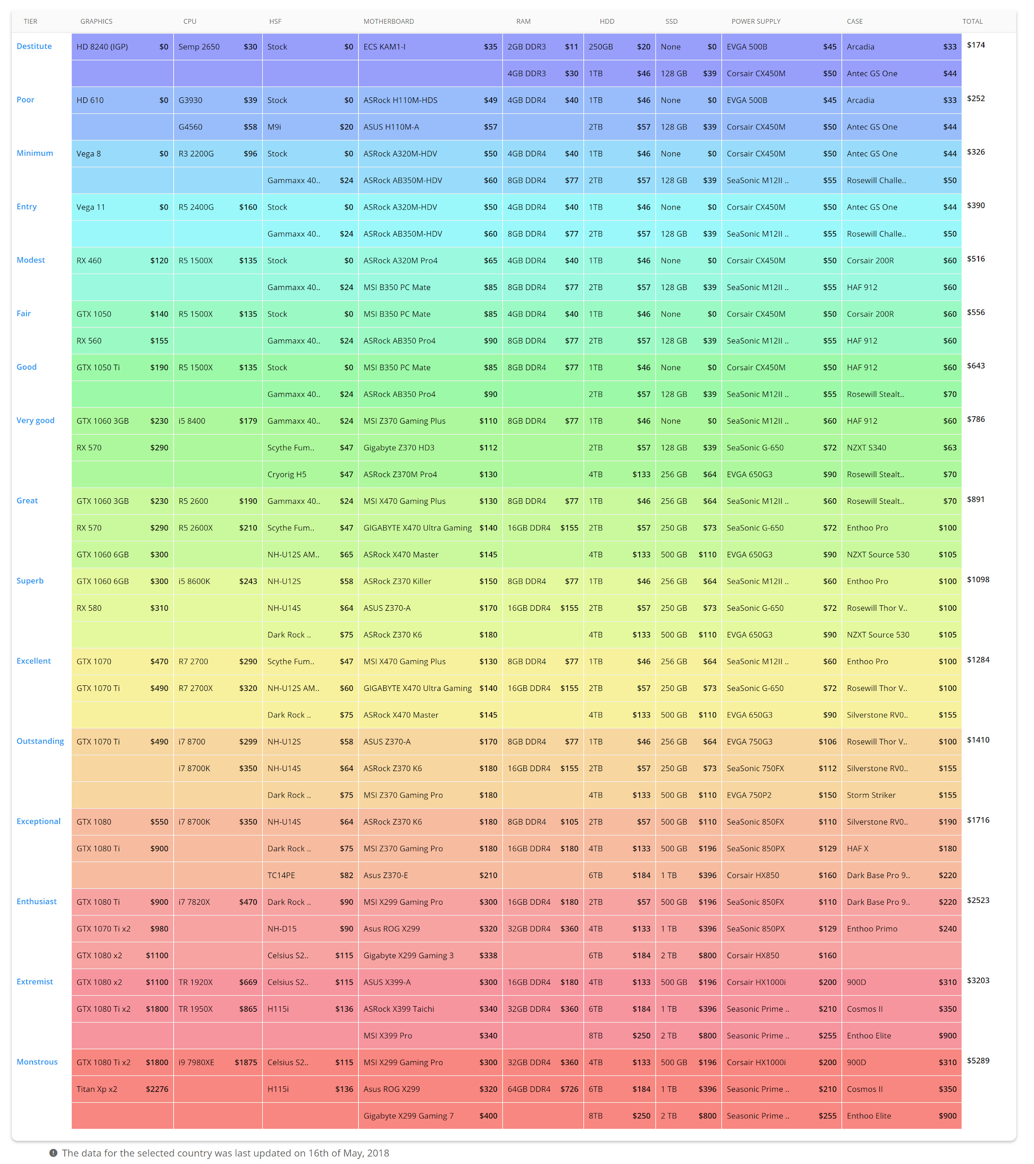
The Logical Increments Parts Table

Slide 4
Users want to:
Browse lots of information at once e.g. multiple computer parts, technical specs and prices;
Compare products e.g. how they perform against each other and across games;
Make a decision and buy directly from Amazon.

Slide 5


Challenges:
“Good data tables allow users to scan, analyze, compare, filter, sort and manipulate information to derive insights and commit actions.”
Andrew Coyle - Flexport

Slide 6
PARTS TABLE

Slide 7
TOPICS and PROPOSED IMPROVEMENTS
Sorting Columns
Table Layout Controls
Filtering
Country Selection
Fixed Header Row and Column
Searchable Columns
Resizable Columns
Modal Behaviour
Modal Expandable Cells / Rows
Draggable Modals
Visual Table Summary
Other Improvements

Slide 8
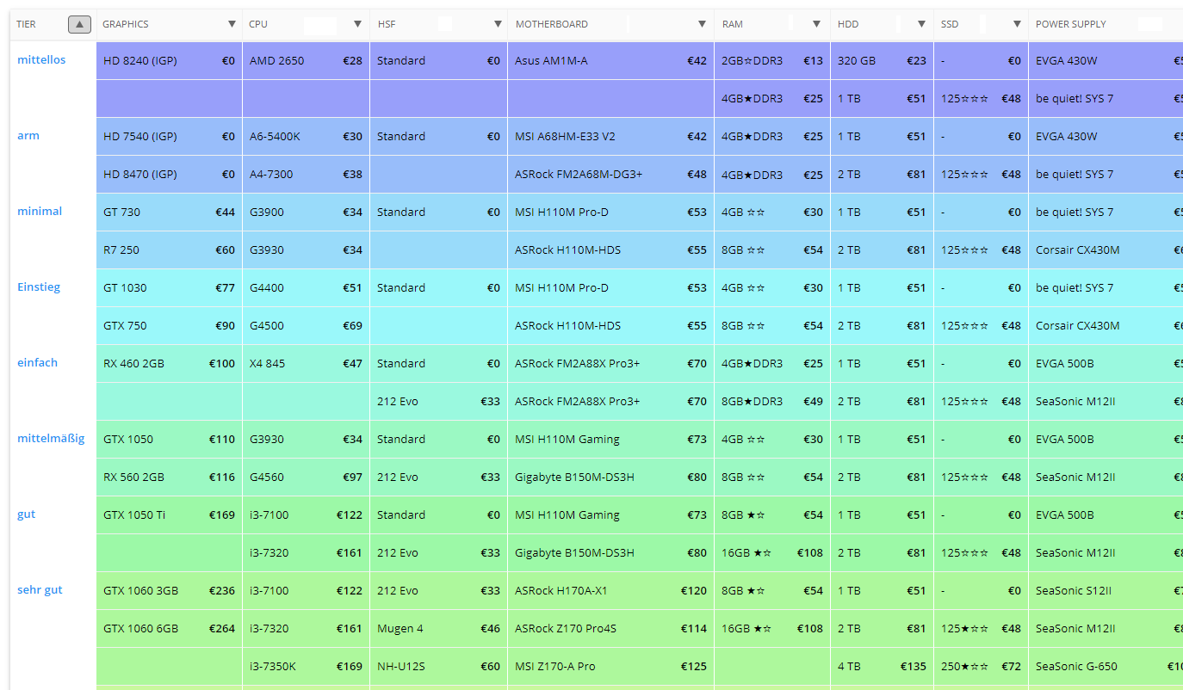
SORTING COLUMNS
Allows users to organize rows alphabetically/numerically. This gives the user more control over their visualization without being an invasive feature.
This is especially important for the first column: Tier, as the user might want to see the more expensive sets first.
Implementation Note: Whenever a column is modified, such change should be highlighted visually (change color, opacity, add graphics to make sure the user knows there’s a modifier on top of the content)

Slide 9
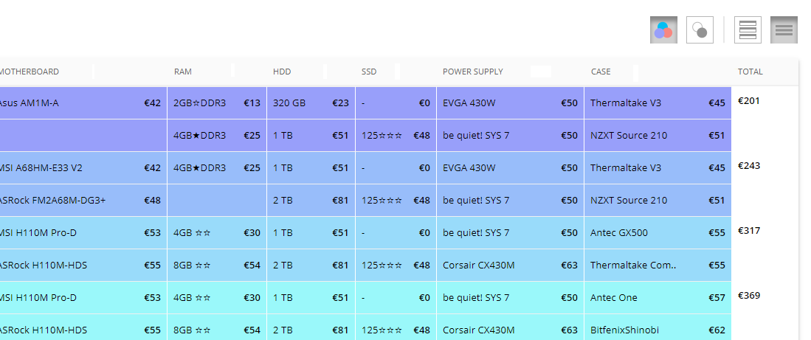
TABLE LAYOUT CONTROLS
For the user to explore the table, it’s convenient to offer different visualization and layout options such as:
Color Toggle: Rainbow layout vs B&W table (B&W could also include Zebra vs No Zebra);
Density of row Toggle: Dense layout (compact) vs “Airy” layout (with more whitespace);
(Advanced) Detail level: “Simple” vs “Advanced” table. The advanced table could expand each row into a detailed view which can include descriptions, prices and possibly a small image. This would be the option chosen by users who want to see what things look like and make easier comparisons between rows.
(The design is just illustrative)

Slide 10
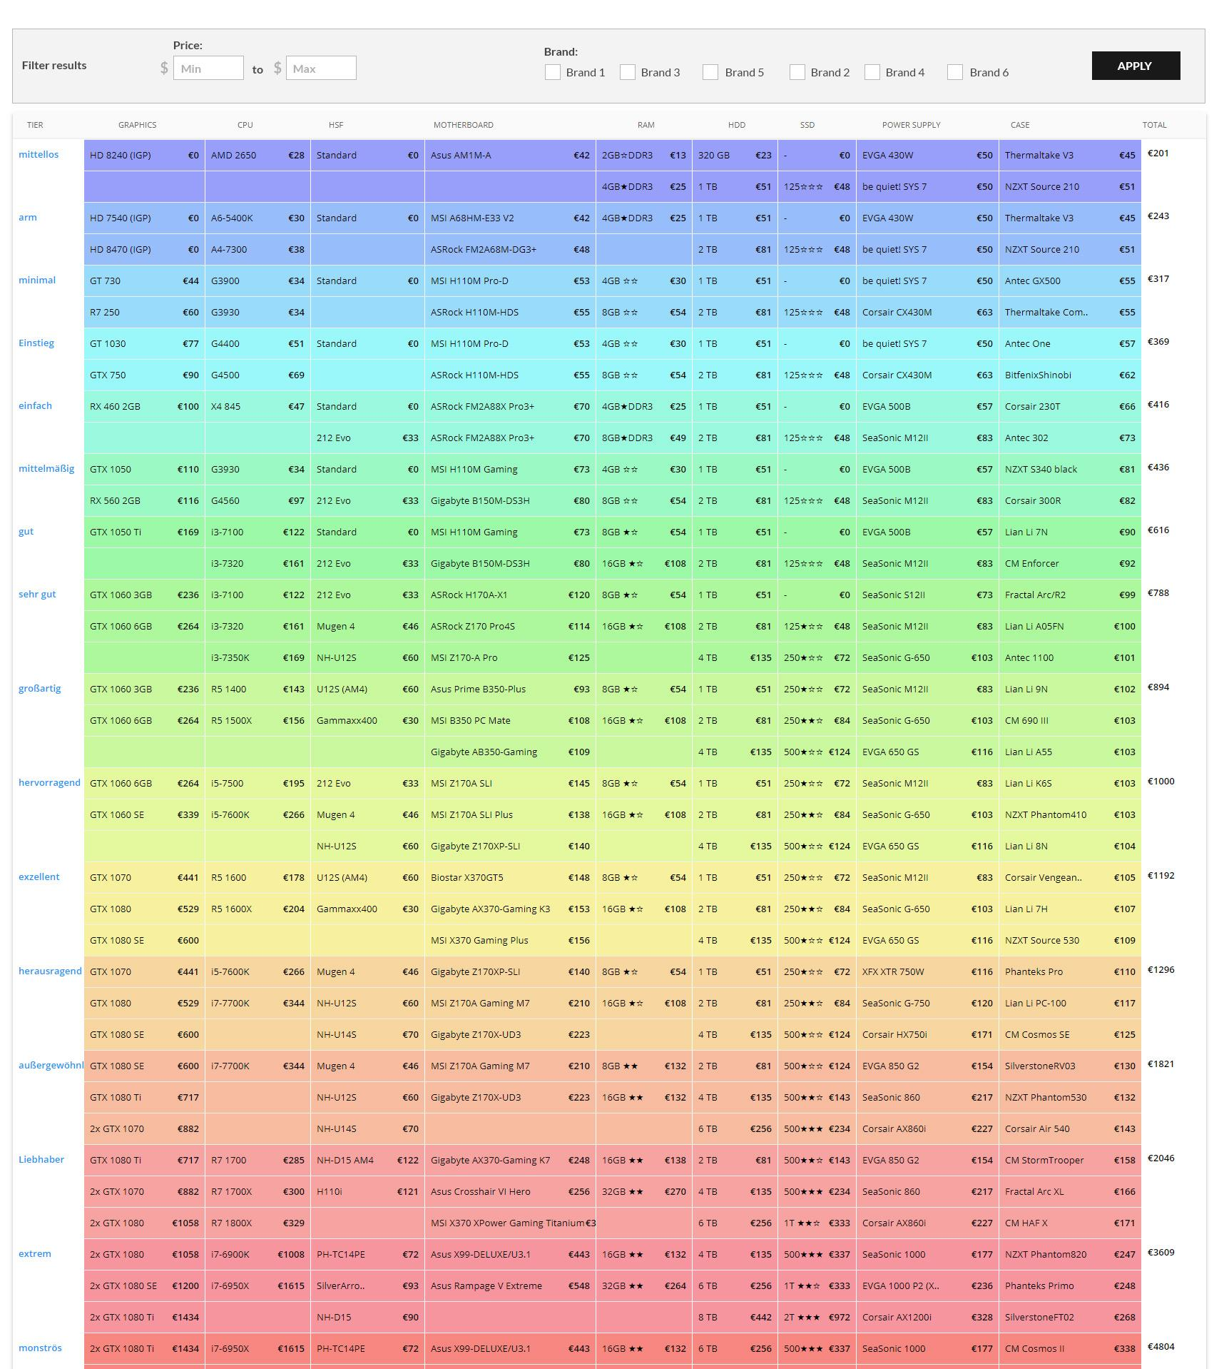
FILTERING: Global
Filtering allows users to manipulate the data presented in the table.
The Filtering can happen at the level of the whole table (for example, filter by price range of all cells, favorite brands, etc), or at the level of the column.
An example of top bar (or whole table) filtering with price range and brands:

Slide 11
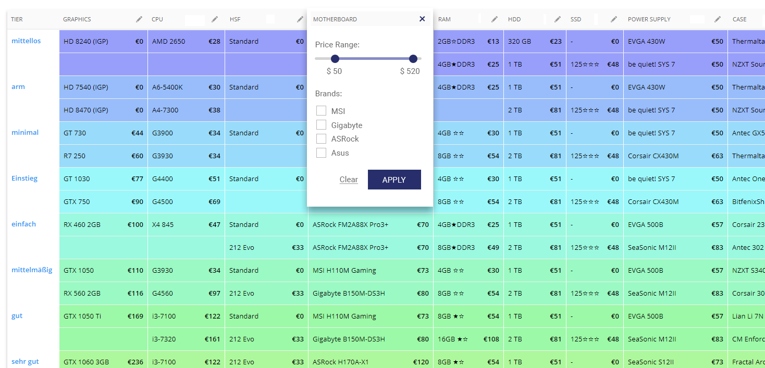
FILTERING: Column
An example of column filtering in a modal, that applies changes to each collection.
(The design is just
illustrative)

Slide 12
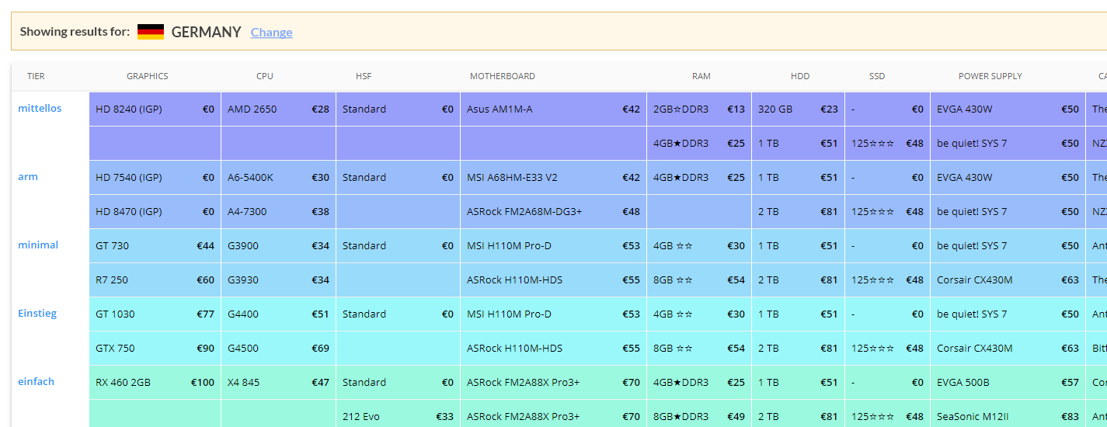
COUNTRY SELECTION
The visibility of the country selection (and the consequences of changing it) is an issue. The user doesn’t automatically notice there’s something changing their selection, except perhaps because of the language of the Tier, because the control is small, unformatted and positioned on a corner that is “secondary” compared to the Tier.
Since this is a great feature, it would be good to highlight it, and bring to attention to it and in particular its active modification of the table content.
The country selection affects the language and the prices, so it helps to have it closer to them.
Something that affects the whole table should visually convey its importance as well.

Slide 13
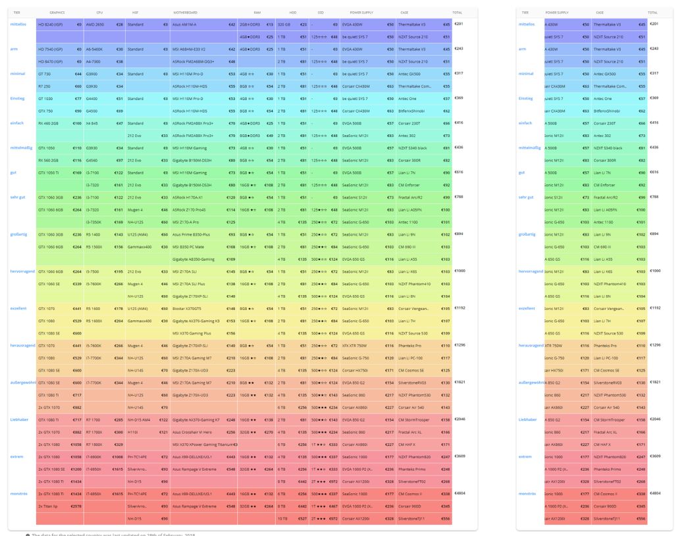
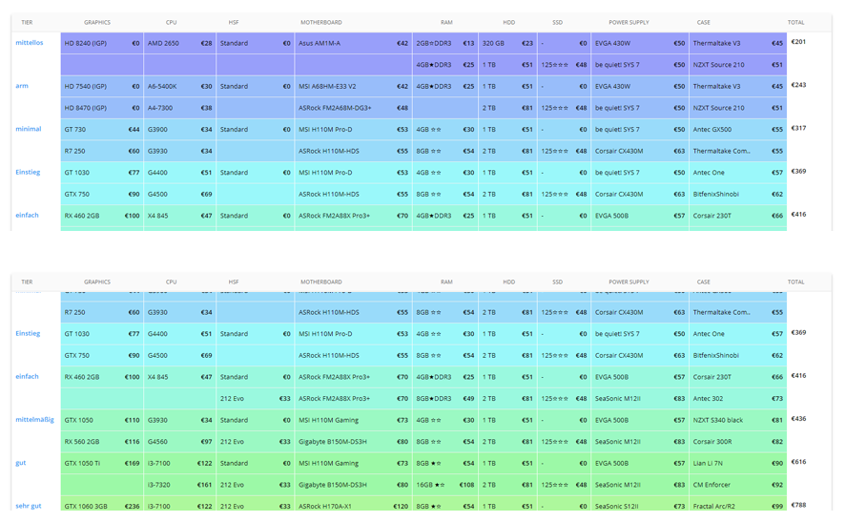
FIXED HEADER ROW AND COLUMN
Fixed column and row headers are a great way to facilitate the exploration of tables without ever losing the context. It allows for easier scrolling and is great for large data sets.
Fixed Header: Already implemented. Fixed 1st Column: To facilitate navigation, in particular for mobile. Fixed Last Column: To explore prices more conveniently.

Slide 14
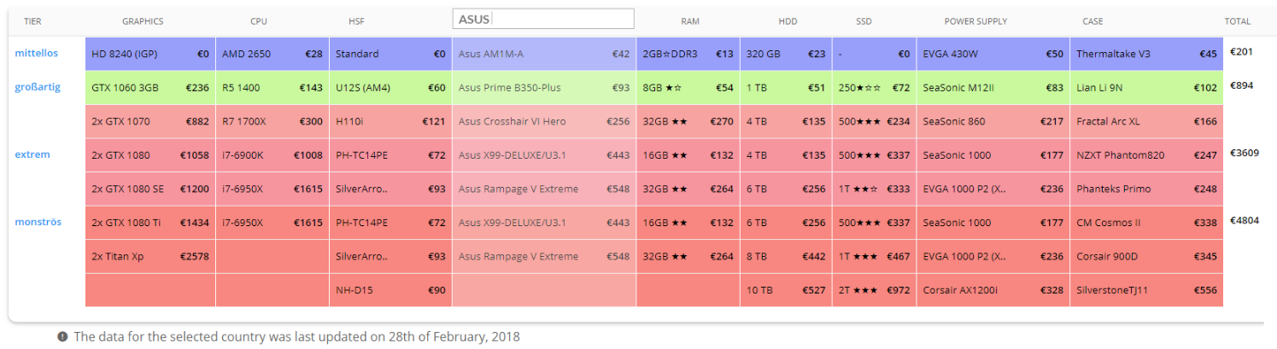
SEARCHABLE COLUMNS
Clicking on the head for the column allows the user to Search (or Filter) inside such column. Advantages: Instant feedback if the results are updated live. User can limit the results to what they are looking for, but the context (and color) is conserved.

Slide 15
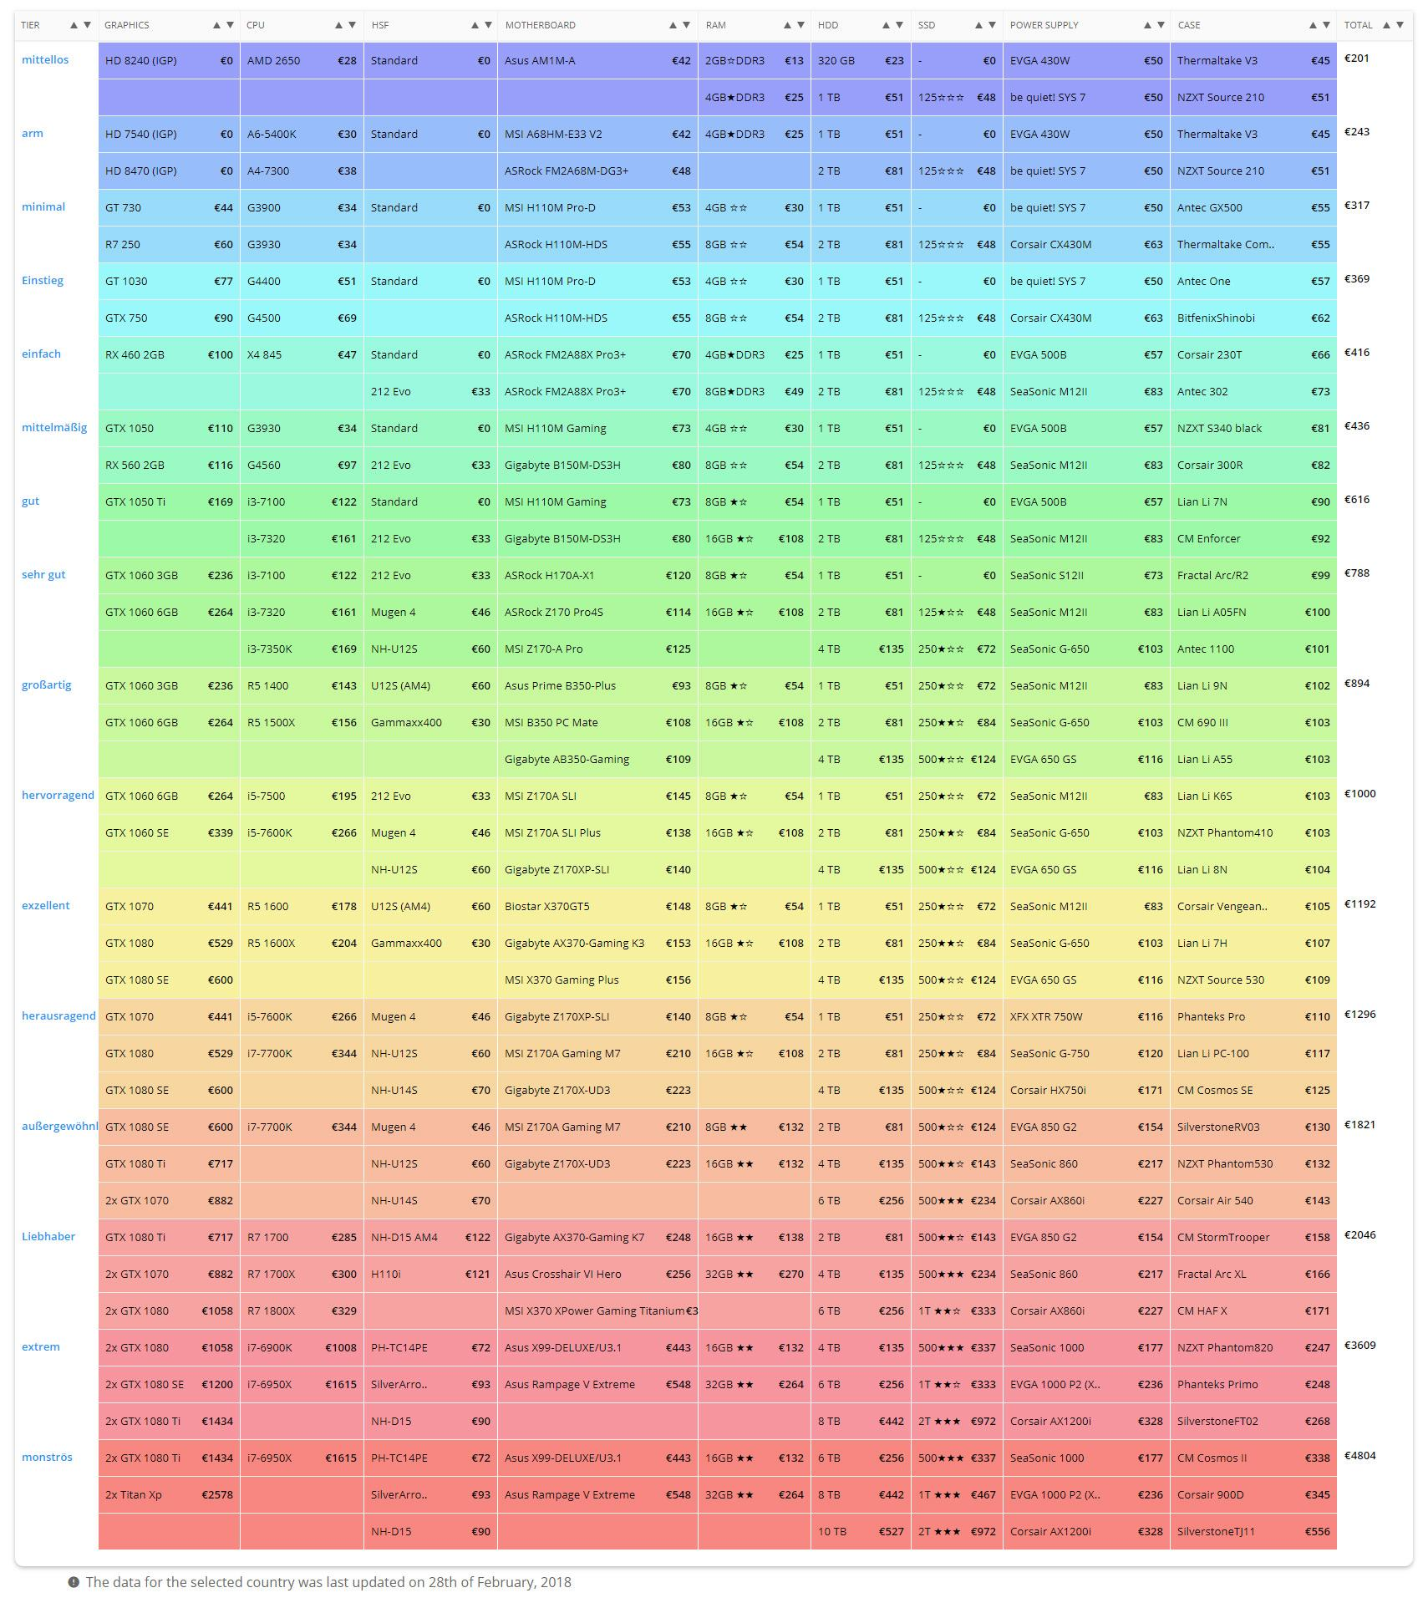
RESIZABLE COLUMNS
Resizable columns are good for seeing abbreviated information in full, and as a change they have very low impact if the person doesn’t want to use the functionality.
Implementation note: It requires lines that the user can mouse-over.
The resize happens only in the column header

Slide 16
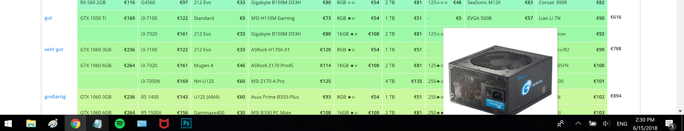
MODAL BEHAVIOUR
Currently, the modal opens in place on mouse-over (which doesn’t work for mobile). The modal is not listening to where it’s opening, so it sometimes gets chopped out of the visible area. One way to solve this issue is to use JS (or similar) to calculate the position of the modal and make it open in a certain direction.
An example of a modal disappearing down the visible area:

Slide 17
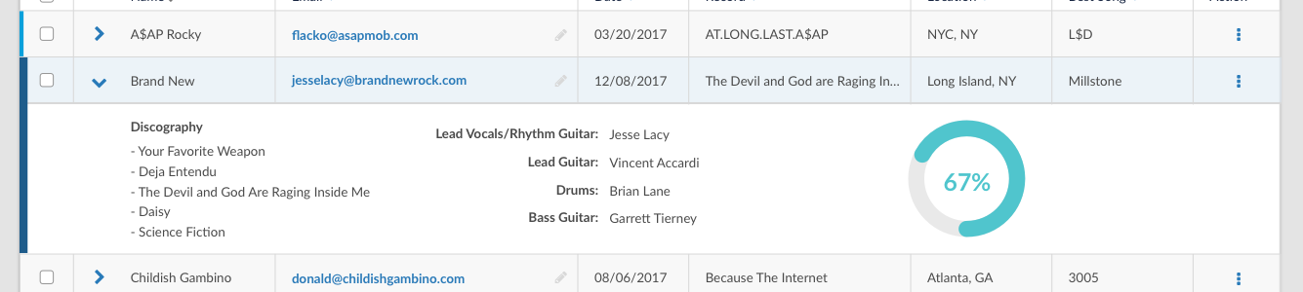
MODAL VS EXPANDABLE CELL/ROWS
Expanding a row within a data table is now a common pattern found across a myriad of applications. This is related to the Table Layout Controls, in that a row could be expanded to show more information in place (downwards) as opposed to in a modal. High Impact, evaluate Amazon strategy.
Mouse-over
Click
-
Click:
Link to Amazon
Link to Amazon
Example of expanding row

Slide 18
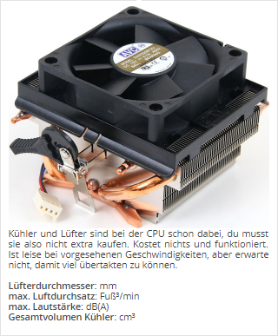
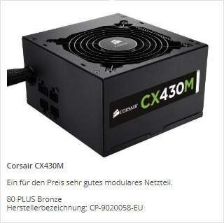
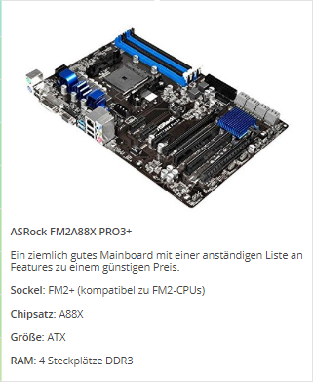
DRAGGABLE MODALS
While the current modals open on mouse-over and remain so until the mouse moves away from the “hot spot”, this is not necessarily the case for all modals. Modals could be dragged and moved around. High Impact: This would require a change in the mouse-over vs click behaviour similar to the one mentioned in the previous slide.
Advantages: This is specially useful to compare products side by side.
Disadvantages: Not (easily) available for mobile.

Slide 19
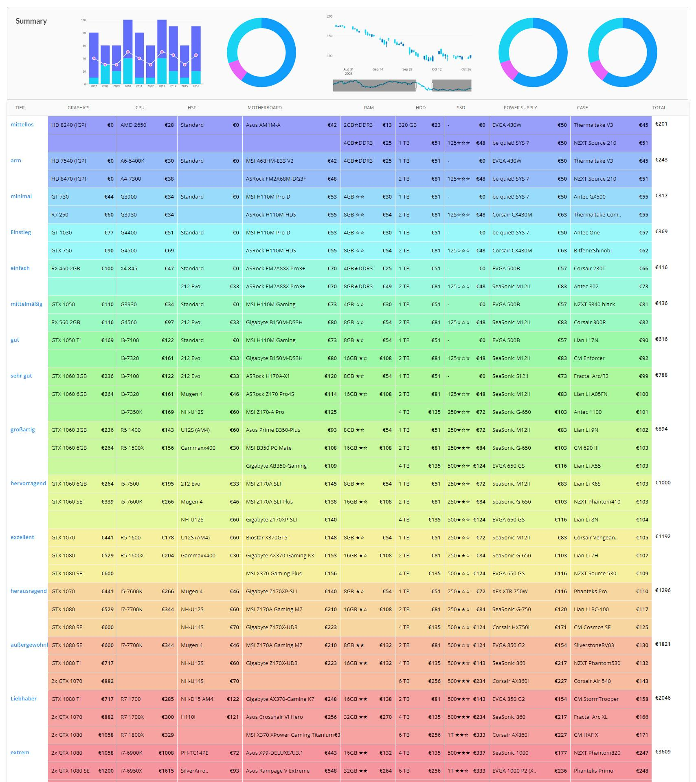
VISUAL TABLE SUMMARY
(LOW PRIO) - A top graphic illustrating the results of the table. Charts, graphs, totals - It provides an overview of patterns, issues, aggregates and gives insights.
Charts can show the changes in prices, the share of brands, the evolution of certain products or series, and other related topics.
The advantage is a quick overview of the table contents, an introductory element.

Slide 20
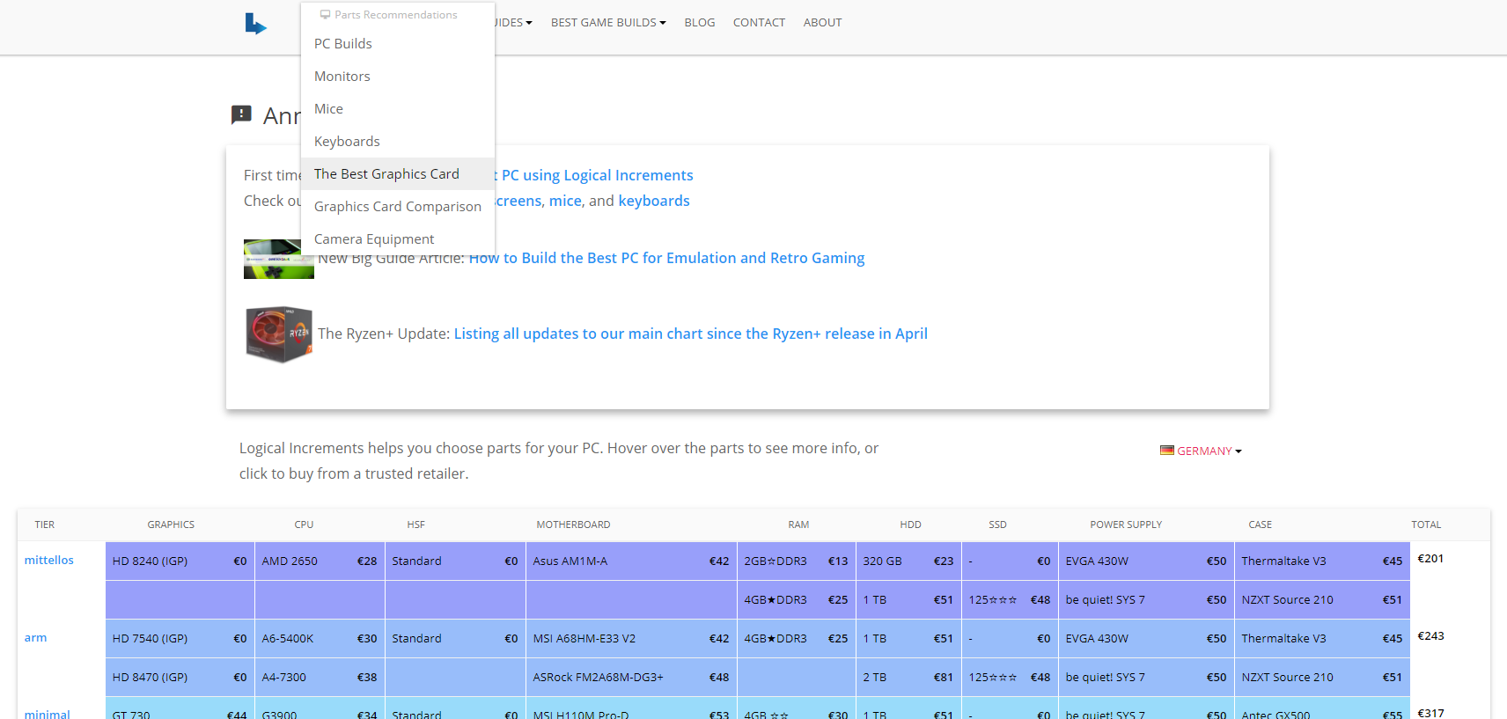
ADDITIONAL: Link to Pages
Since each computer part has a page, these (when available) could be linked from the parts table:

Slide 21
ADDITIONAL: Loading Indicator
The parts table takes a little while to load, a loading indicator would be useful as the content is currently pushed down once the table has loaded. Keeping a fixed area will prevent elements from moving, and users from losing context of what they were reading.

Slide 22
INTERACTION: Customize Columns
INTERACTION: Mouseover Cell Actions
Possibility to customize columns and their content, as well as rearrange or delete them completely. Settings can open in a modal to allow for more filtering options such as price range, brands, etc.
Implementation Note: It’s essential that the user understand very clearly that changes have been applied to the default table.
Extra options can be added to cells on mouse-over, such as remove. This level of control is probably not required for the parts table, but it’s good to keep in mind for future expansions. Be aware of discoverability issues (the user never noticing this functionality) and/or responsive replacement for mobile.

Slide 23
PRODUCT MODAL

Slide 24
TOPICS and PROPOSED IMPROVEMENTS
Type of Modal
Tier Modal
Product Modal
Standardization of Data
Image Treatment
Content Formatting
Color Cues

Slide 25
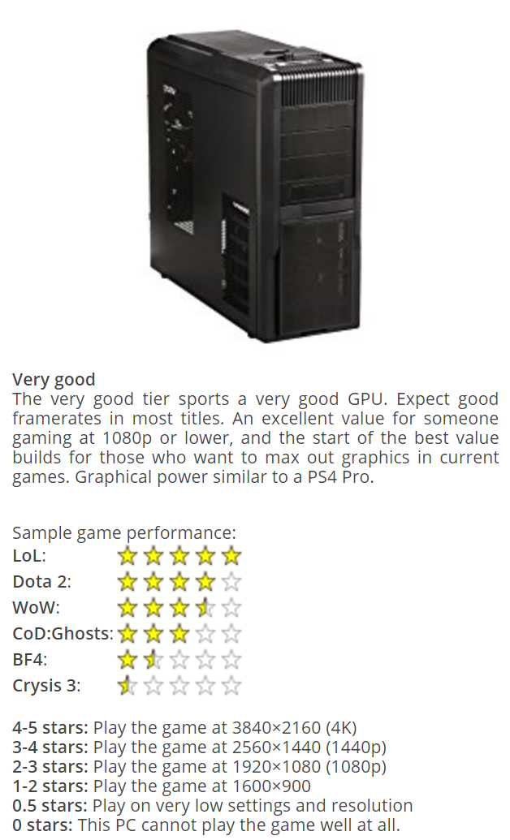
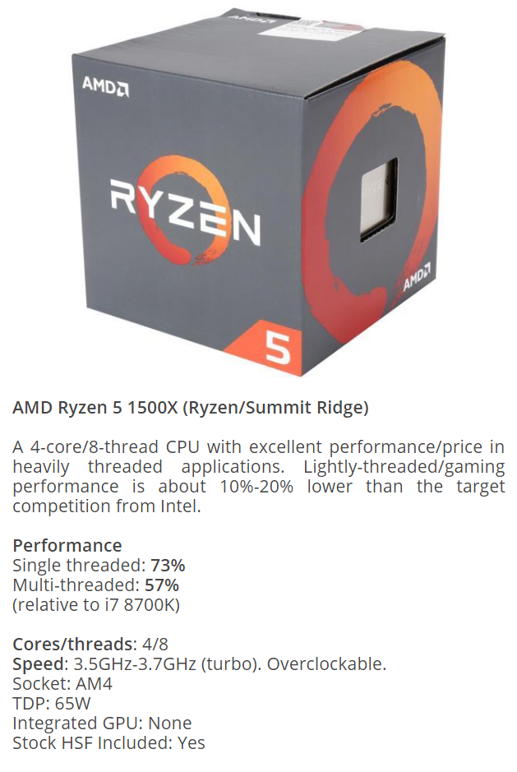
TYPE OF MODAL
Product
There are currently two types of modals that behave similarly but offer different content:
TIER modal
PRODUCT modal
A clearer distinction between the two would be useful for the user to understand easily what the parts table is about.
Tier

Slide 26
TYPE OF MODAL: TIER
The Tier modal contains:
Headline (name)
Description
Sample game performance
Issues:
No text formatting - all text looks the same in size and style. No visual cues to easily scan for important info.
Headline too small - difficult to see!
Game performance stars look like product ratings. This is an issue because the functionality is different. The component resembles a legend, too, especially the bottom part.
1
2
3

Slide 27
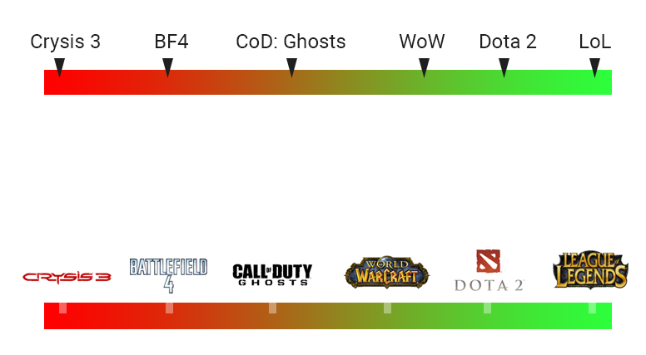
TYPE OF MODAL: TIER (Sample game performance enhancement)
Examples of visual design for game performance

Slide 28
TYPE OF MODAL: PRODUCT
The Tier modal contains:
Image
Headline (name)
Description
Technical Data
Warnings and Notes
Issues:
Very little text formatting - only titles are bolder.
Headline too small - Difficult to see.
Technical data is different in each product, even inside same row. Difficult to tell where to add spaces.
Sometimes there’s extra information in “5”, highlighted in red - this component also looks unformatted.
1
2
3
4
5

Slide 29
STANDARDIZATION OF DATA
The data shown in the Product Modal doesn’t look (too) standardized. What can be done to make sure it’s as easy as possible to compare products? Especially products of the same type.
All products should have:
An Image
A Title (one line of text, highlighted in size or color)
A Description (about three lines of plain text)
A set of Technical specs (following a certain convention if possible)
Notes (smaller in size, so they don’t get confused with the rest of the data)
If possible, the length of these blocks should be similar, so the modals aren’t too different in looks.

Slide 30
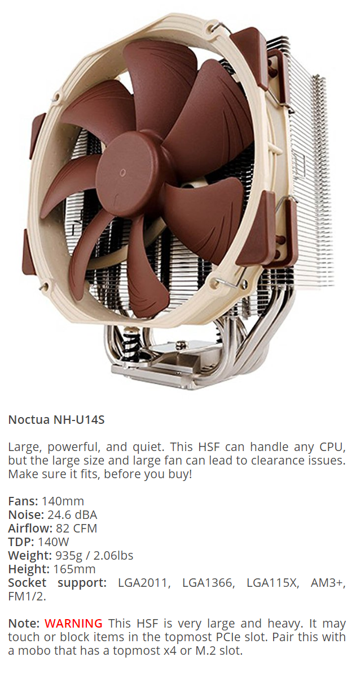
IMAGE TREATMENT
Images are currently presented in different sizes and ratios. There seems to be a border around them, although it’s very small and the image sometimes feels too close to the edges.
Having a standardized size and ratio for the images could help with layouting, loading times and comparisons.
Standardize image size and ratio - If images are not available for download, this can be done with CSS.
Standardize and increase white space around image for legibility.

Slide 31
CONTENT FORMATTING
Text is mostly unformatted, making it difficult to scan and read.
Increase font size for title, so it can be easily read and distinguished from the rest of the content.
Add bold and italics text when needed (this example already has it), and make secondary text smaller (Notes)
Possibly differentiate sections of the modal with color or dividers.
Add price?

Slide 32
COLOR CLUES
Tier: MINIMUM
(Low Priority)
The modal of the product selected could show a border with the color (and possibly name) of the price tier, for quicker identification and comparison.
This is particularly useful at this level as the modal doesn’t show a product price.

Slide 33
RESPONSIVENESS

Slide 34
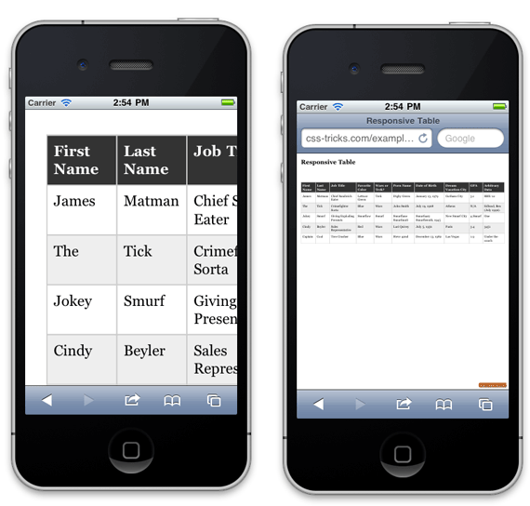
Responsive Tables: Problem
Both are equally bad!

Slide 35
Responsive Tables: Scrolling Direction
Vertical
scroll
Horizontal scroll
Horizontal inner scroll
Sticky header

Slide 36
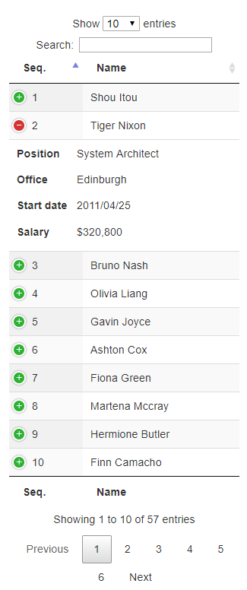
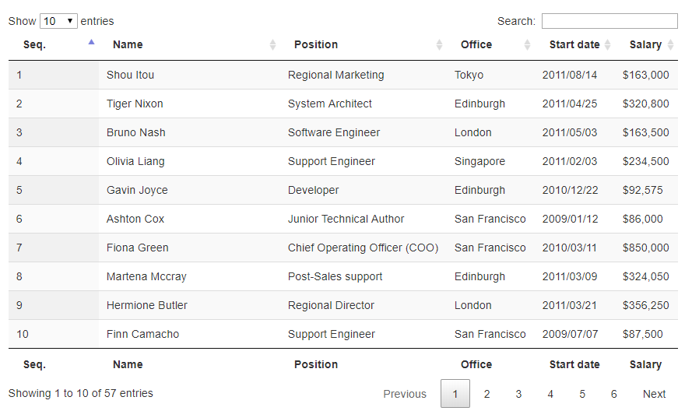
Responsive Tables: Vertical Scroll + Expander

Slide 37
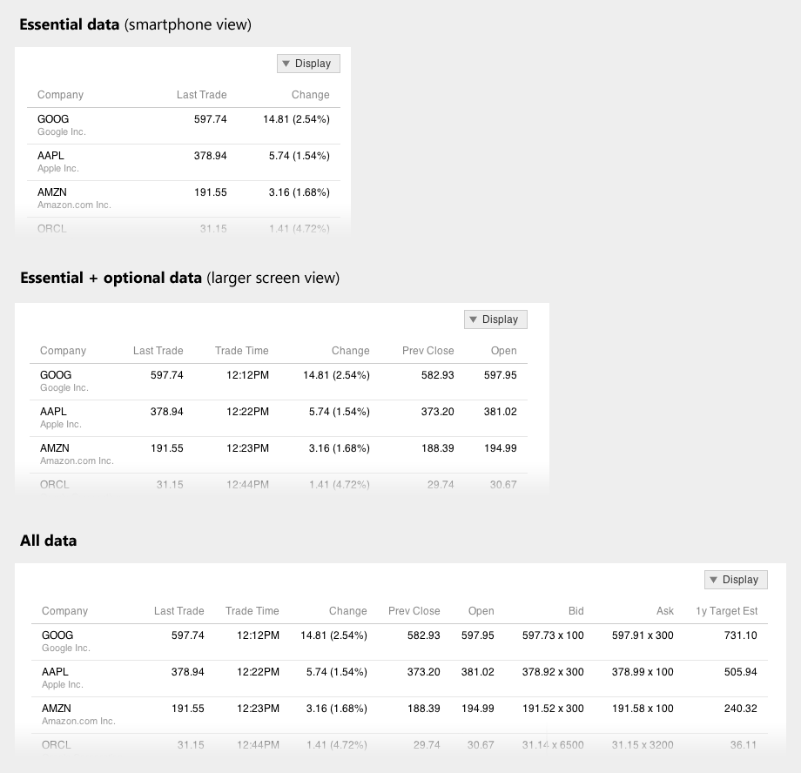
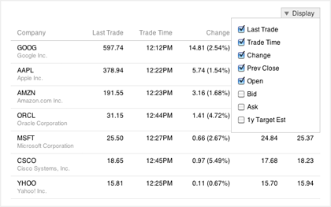
Responsive Tables: Choose what to Show

Slide 38
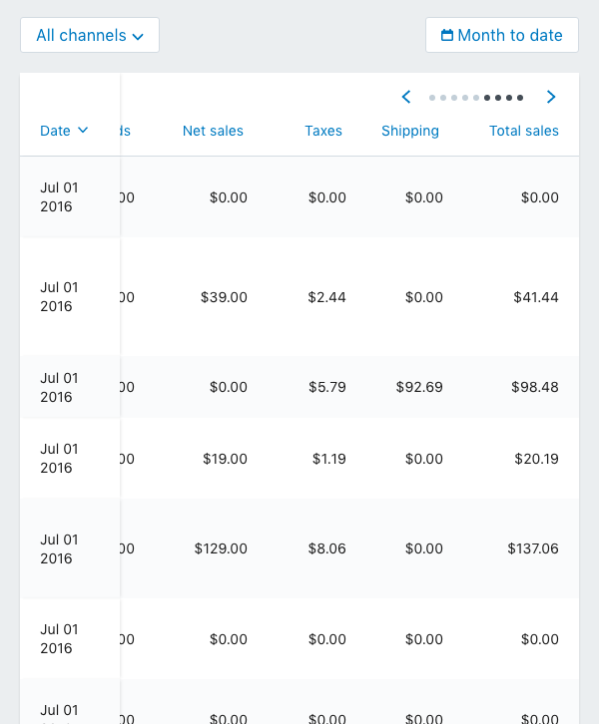
Responsive Tables: Sticky Headers

Slide 39
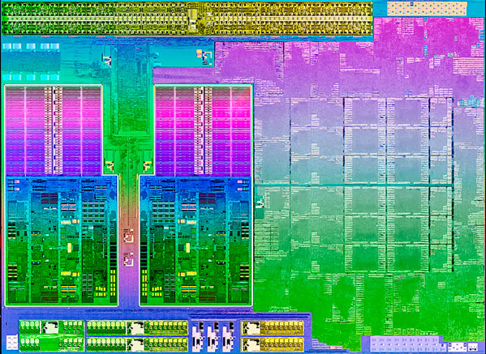
Responsive Tables: Suggested Solution
STAGE 1
STAGE 2
Graphics
Graphics
DESTITUTE $170
AMD Radeon HD 8240 IGP
$ 25
AMD Radeon HD 8240 IGP
$ 25
Graphics
CPU
Horizontal inner scroll
Sticky header
HSF
The HD 8240 is a very weak integrated GPU, suitable for light-weight gaming at low settings and resolutions. It cannot handle most modern titles, but can play old games.
Motherboard

Slide 40
TESTING PLAN

Slide 41
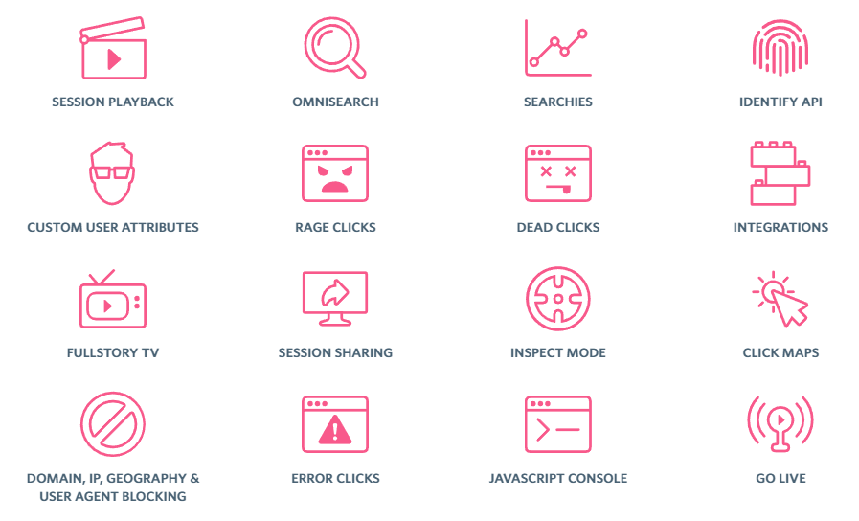
TESTING PLAN: 1. Session Replay
Sites like www.fullstory.com records and reproduces real user experiences on the site.
These services are an easier, cheaper way to run observations on an online site.
You can search sessions based on any combination of attributes and events, or use pre-defined ones such as: User Attributes, Segment based on Engagement, sessions with signs of Frustration, isolated by Source, Device, OS, or Location, and more.

Slide 42
TESTING PLAN: Eye Tracking
Eye tracking tests allow for us to see what people are looking at, what captures their attention and how clear the different functionalities are.
Measure and compare:
Paths of eye tracking - What catches the user’s attention the most, and what follows? Is there an order to the way they observe and navigate?
What areas are getting the most attention? Are these consistent? Are the areas we want to highlight as well, or are there distractions?
Are users reading the text in the modals, or quickly scanning? Are they inspecting the images?
If new features are introduced, are they easy to see and action?
Some sites that do online eye tracking: https://www.realeye.io/ (full remote) https://xlabsgaze.com/ (webcam plugin)

Slide 43
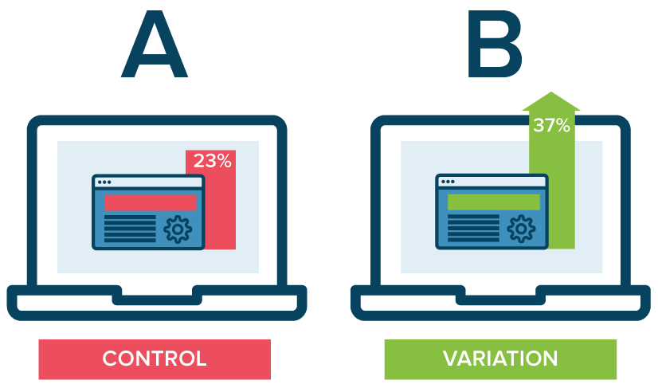
TESTING PLAN: 2. A/B Testing
A few A/B tests are probably the easiest way to test updates to the table, in particular new features one by one.
Provide half of the visitors to the site with a version of the table, and the other half with another. For example, implement one table with column sorting, and one without.
Measure and compare:
Time the user spends looking at the table (before dropping or buying);
Visibility and Usage of feature;
Amazon clicks and conversions.

Slide 44
TESTING PLAN: Focus Group / Observation
Focus groups, observations and interviews are great ways of watch a person interact with the site live as they perform a series of scripted actions. Having a person next to them, they can ask questions and redirect behaviour to test.
With a script prepared beforehand, explain briefly what the site does, and what is expected of the user (normally, an introduction followed by some time for the user to navigate freely, and then a set of 3 to 5 tasks give good results);
Allow for the user to provide feedback as they interact with the site;
Interview users afterwards to get feedback on blocks as well as suggestions.

Slide 45
Thank You!

